Slide 1

Exploratory Data Analysis
G2M Insight for Cab Investment Firm
17/08/2022

Slide 2

XYZ is a private firm in US. Due to remarkable growth in the Cab Industry in last few years and multiple key players in the market, it is planning for an investment in Cab industry and as per their Go-to-Market(G2M) strategy they want to understand the market before taking final decision.
Objective : Provide actionable insights to help XYZ firm in identifying the right company for making investment.

Slide 3
Approach
Review the Source Documentation
Understand the data
Identify relationships across the data
Clean the Data
Analyse the data
Conclusion/Summary
The questions to decide which investment opportunity is better are:
Which is more popular by customers?
Which cab company has more overall Users and covers majority of cities?
Which company has had more profit?
Which Cab Company has more loyal users?
Which company has maximum cab users between 2016 - 2018?

Slide 4
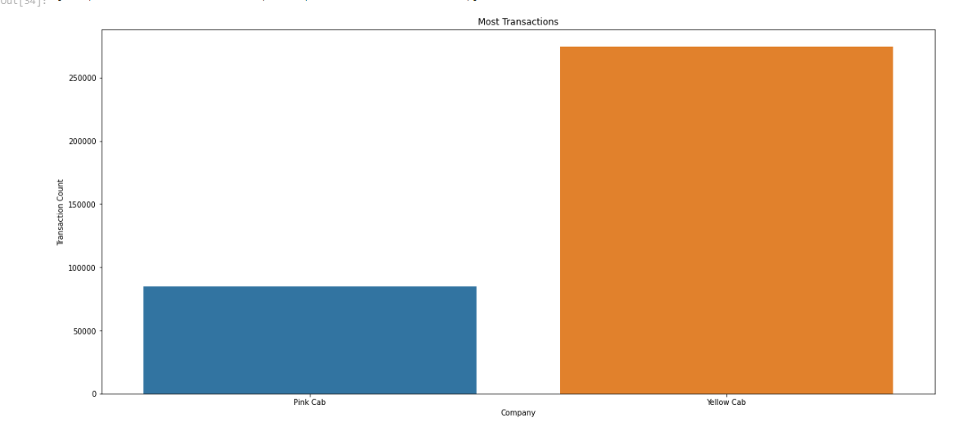
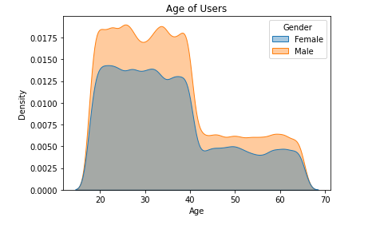
Which is more popular by customers?
The Yellow Company are shown to have more transactions which shows they are more used than the Pink Cab
The most Popular Company looks to be the Yellow Cab Company. They are significantly more popular with men between ages of 20 - 40

Slide 5
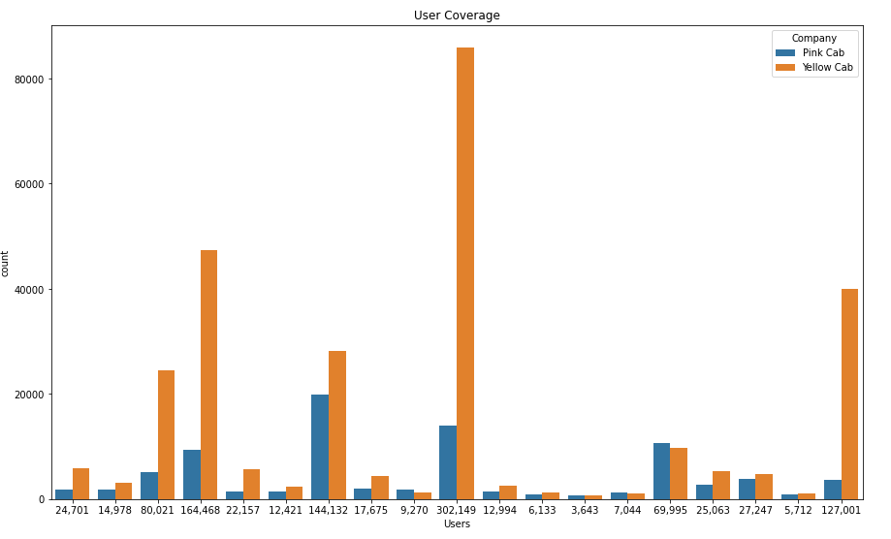
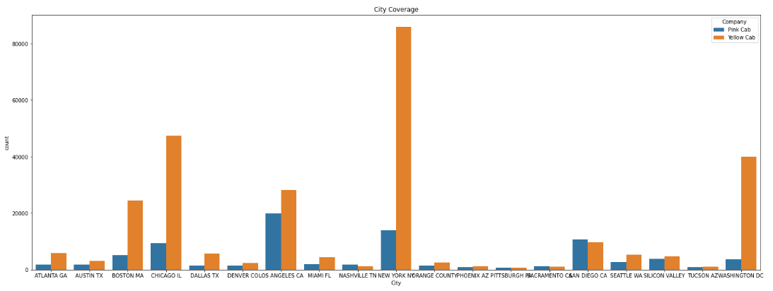
Which cab company has more overall Users and covers majority of cities?
The Yellow Cab covers majority of cities specifically New York. The yellow cab also has more users overall in majority of cities

Slide 6
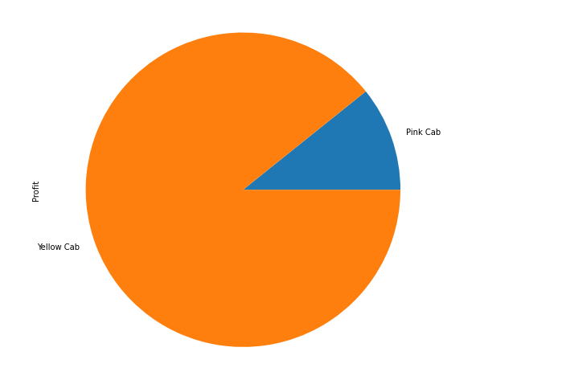
Which company has had more profit?
The yellow cab has earned more profit than the pink cab by 8.3 times

Slide 7
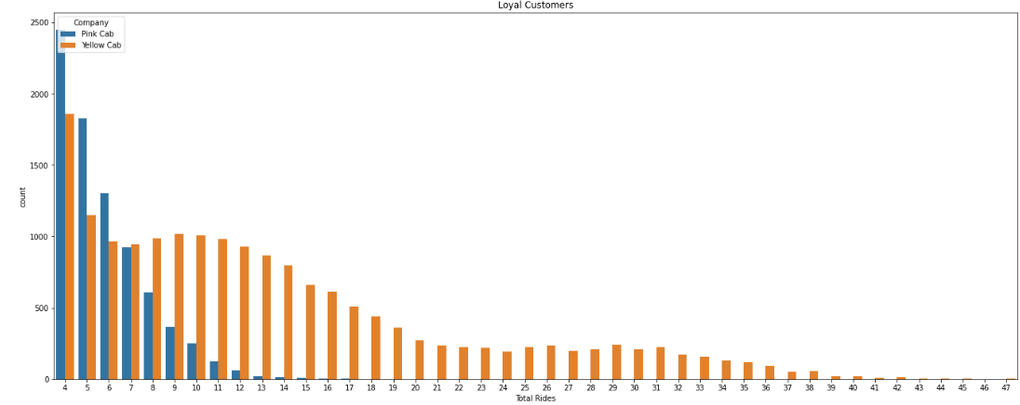
Which company has more loyal users?
Yellow Cab Company have more loyal riders than Pink Cab Company

Slide 8
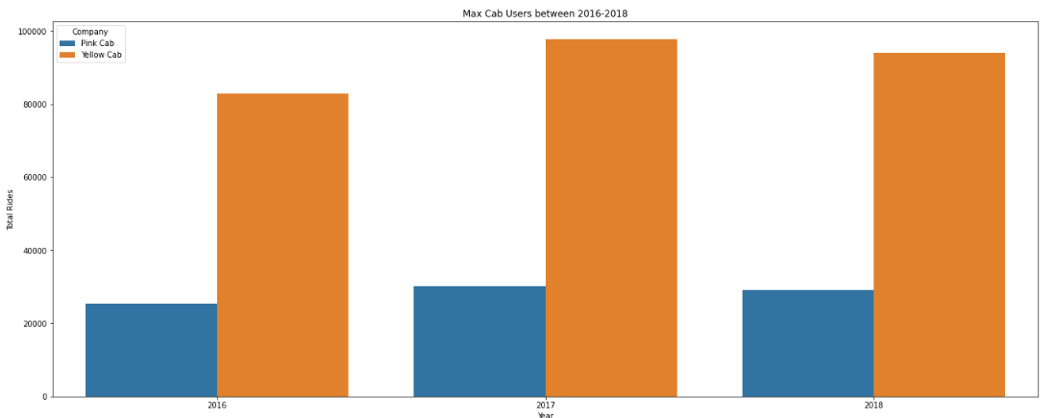
Which company has maximum users between 2016-2018?
The Yellow Cab Company have had an increase in Users since 2016 and has the most users compared to the Pink Cab Company

Slide 9
Recommendation
Based on the findings of the analysis. We can confirm that the Yellow Cab company should be invested in because it will generate more profit and have more users in most cities. The Yellow Cab Company has a larger user base than the Pink Cab Company. Yellow Cab has more loyal customers. The Yellow Cab Company provides a broader range of cabs for users to access in various cities. Finally, the Yellow Cab company has seen an increase in users since 2016.

Slide 10

Thank You

